Slide 1
Fast Fourier Transform (FFT)
Please answer this questions:
What is the FFT
Where it is used (realistic scenario)
What is its purpose
You will learn about:
How to compute their coefficients by hand, to be explained here in class
Remember that you are required to implement a radix two FFT. Not any FFT of your choice.
Radix 2 FFT → Decimation in Time → Cooley Tukey Algorithm

Slide 2
Some Resources and Nice Videos
https://www.youtube.com/watch?v=ykNtIbtCR-8
https://www.youtube.com/watch?v=XtypWS8HZco
https://www.algorithm-archive.org/contents/cooley_tukey/cooley_tukey.html
https://www.youtube.com/watch?v=r18Gi8lSkfM
https://www.youtube.com/watch?v=ds0cmAV-Yek
https://www.youtube.com/watch?v=spUNpyF58BY
https://www.youtube.com/watch?v=3FAIXEkxyBs (MATLAB)
© David Kirk/NVIDIA and Wen-mei W. Hwu, 2007-2009
ECE 498AL, University of Illinois, Urbana-Champaign

Slide 3
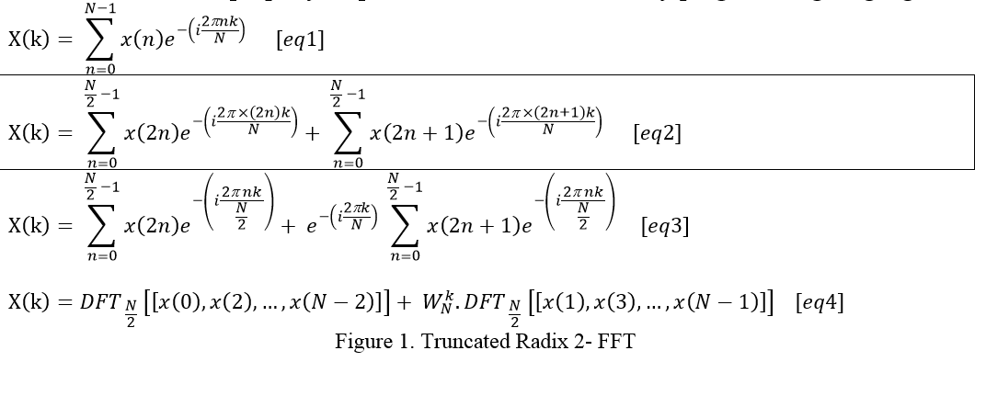
Radix-2 Fast Fourier Transform (FFT)
Signal → 1st fragmentation → Even + Odd
2d Fragmentation:
Even → Real & Imaginary
Odd → Real & Imaginary

Slide 4
Let’s look at an alternative definition
Wikipedia

Slide 5

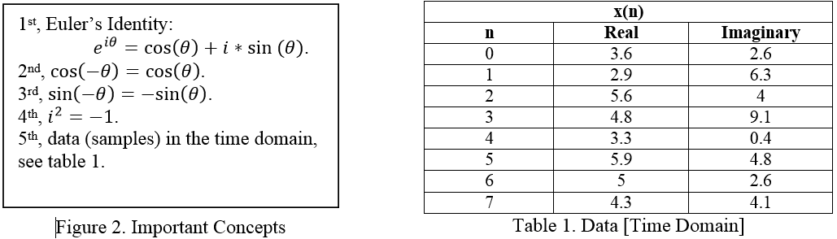
Data

Slide 6
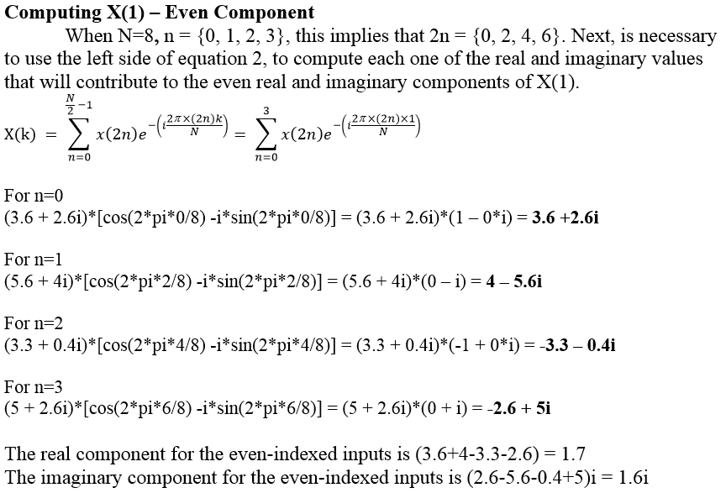
Computing the Even Part

Slide 7
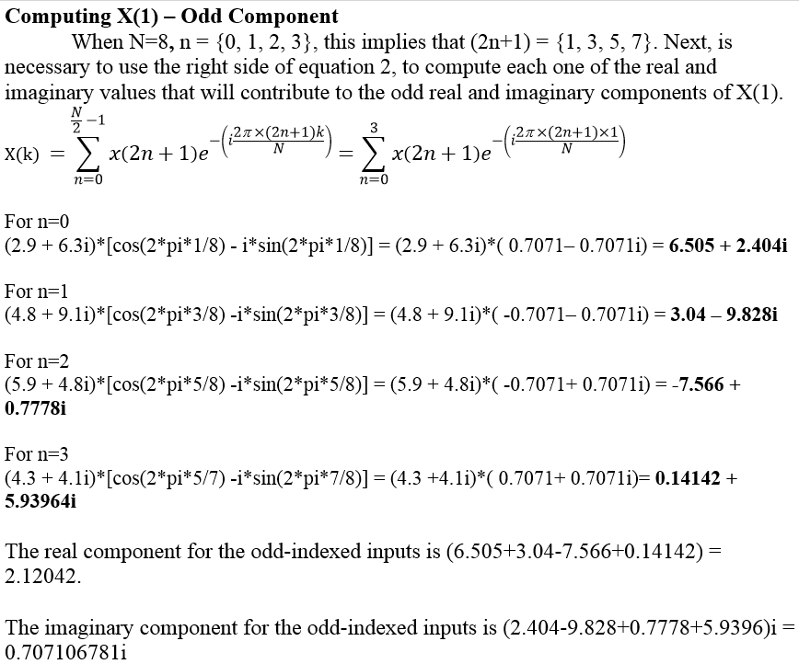
Computing the Odd Part

Slide 8
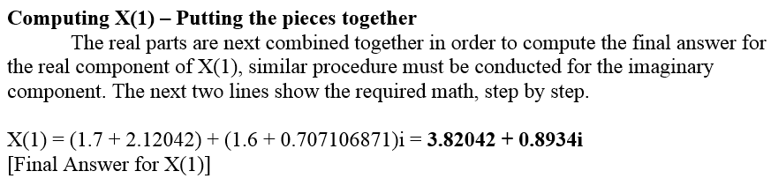
Putting things together

Slide 9
Performance Analysis:
Speedup and Efficiency

